Slide 1


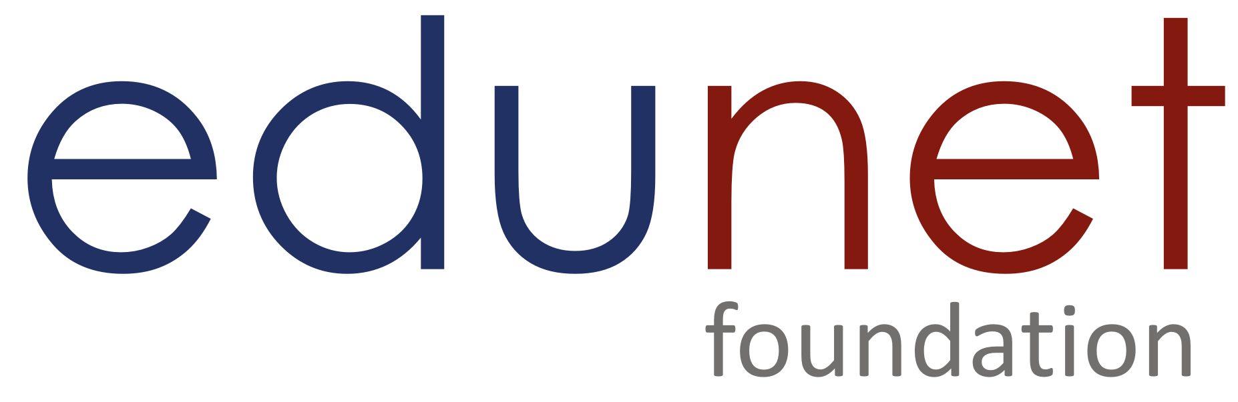

NEXT GEN EMPLOYABILITY PROGRAM
Creating a future-ready workforce
Team Members
College Name
Student Name : Devasree P
Student ID :au711021205006
Info Institute of engineering

Slide 2

CAPSTONE PROJECT SHOWCASE
Project Title
Notes Sharing Web Application using Django Framework
Abstract | Problem Statement | Project Overview | Proposed Solution | Technology Used | Modelling & Results | Conclusion

Slide 3
Abstract
This project aims to develop a user-friendly web application for creating, sharing, and collaborating on notes. Built with the Django framework, the application will provide a secure platform for individuals and teams to manage their notes effectively. Users can create private notes or share them with others, fostering collaboration and knowledge sharing. The application allows users to create, read, update, and delete notes, while also enabling them to share notes with other users. The application's architecture follows the Model-View-Controller (MVC) pattern, with models defining the data structure, views handling user requests, and templates rendering the interface. This project tackles the limitations of traditional note-taking methods by developing a user-friendly web application built with Django. The application empowers individuals and teams to create, share, and collaborate on notes effectively. Users can enjoy features like rich text editing, tagging, secure sharing, and optional real-time collaboration, fostering improved knowledge management and teamwork.
Source :

Slide 4
Problem Statement
Traditional note-taking methods, like pen and paper or standalone digital tools, often
lack features for sharing and collaboration. This can hinder teamwork, knowledge transfer, and efficient information access within groups. Existing note-sharing applications might have limitations in user interface, security, or functionality. Describe the problem you aim to solve with your note-sharing web application. This could include issues such as difficulty in organizing and sharing notes effectively, lack of collaboration features, or the need for a more user-friendly platform for note-taking and sharing. Current note-taking practices, often relying on pen and paper or standalone digital tools, lack functionalities crucial for collaboration. This hinders knowledge sharing, efficient information access, and teamwork.
Source :

Slide 5
Project Overview
This project proposes a collaborative note-sharing web application built with the Django framework. The application addresses the shortcomings of traditional methods and existing solutions by offering: User-friendly interface for creating, storing, and managing notes. Rich text editing capabilities for enhanced note formatting. Secure sharing with specific users or groups. Tagging and categorization for better organization and retrieval.
Optional real-time collaboration features for dynamic teamwork. Categorization and tagging of notes. Sharing notes with specific users or groups
Real-time collaboration capabilities (optional).Version control for tracking note revisions
his project proposes a web application built on the Django framework to address the limitations of traditional note-taking methods and existing note-sharing applications. The application will offer a robust platform for creating, storing, sharing, and collaborating on notes.
.
Source :

Slide 6
Proposed Solution
.
The proposed solution is to develop a Notes Sharing Web Application using the Django framework, providing users with a streamlined platform for efficient note creation, management, and collaboration. This application will feature robust user authentication mechanisms, allowing users to securely register accounts and log in. the solution leverages Django's features to create a secure and scalable web application. Here's a breakdown of the key components:
Models: Define data structures for users, notes, tags, and (optionally) collaboration permissions.
Views: Handle user interactions like creating, editing, sharing, and viewing notes.
Templates: Design the user interface for creating and displaying notes.
Authentication: Implement a user authentication system with secure password storage.
Database: Store user data, notes, and collaboration information (optional).
The application will prioritize user-friendliness and provide intuitive features for managing and sharing notes. Additionally, security measures will be implemented to ensure data privacy and user control over shared content.
Source :

Slide 7
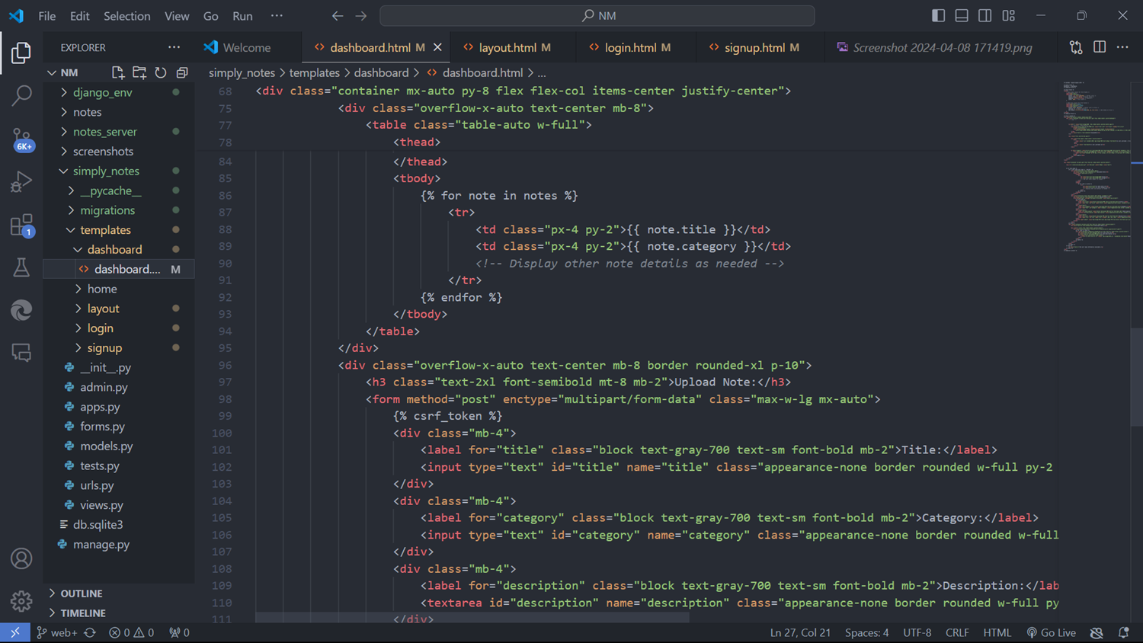
https://github.com/PDevasree1110/notes-sharing-web-application-using-django--NM-project

Slide 8
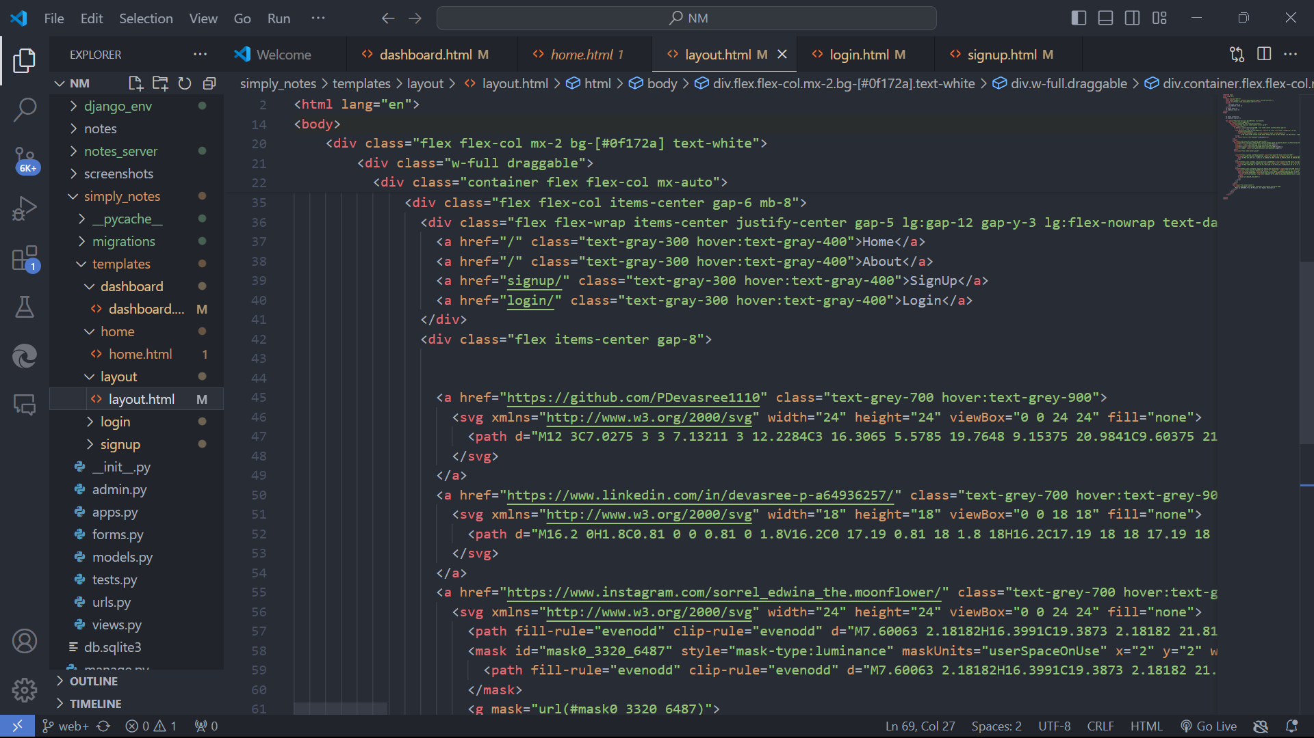
https://github.com/PDevasree1110/notes-sharing-web-application-using-django--NM-project

Slide 9


Technology Used
Front-end
Back-end
Source :

Slide 10
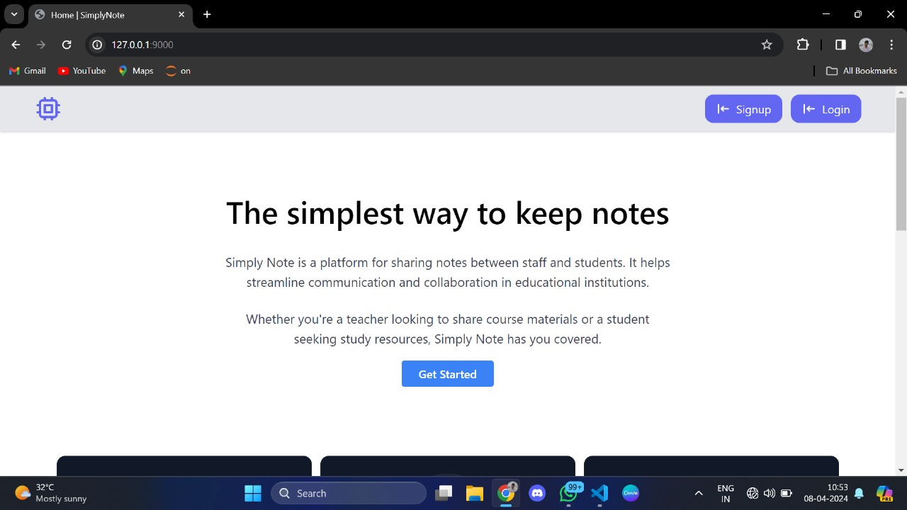
Modelling & Results
Source :

Slide 11
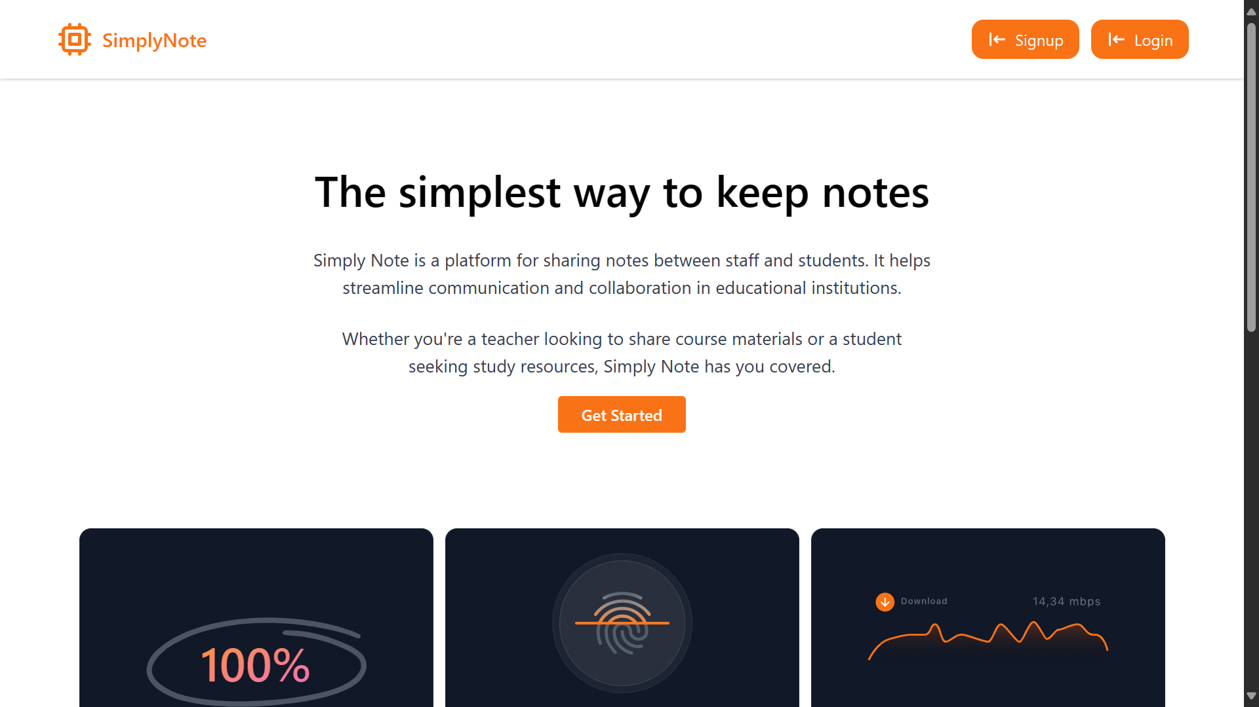
Homepage

Slide 12
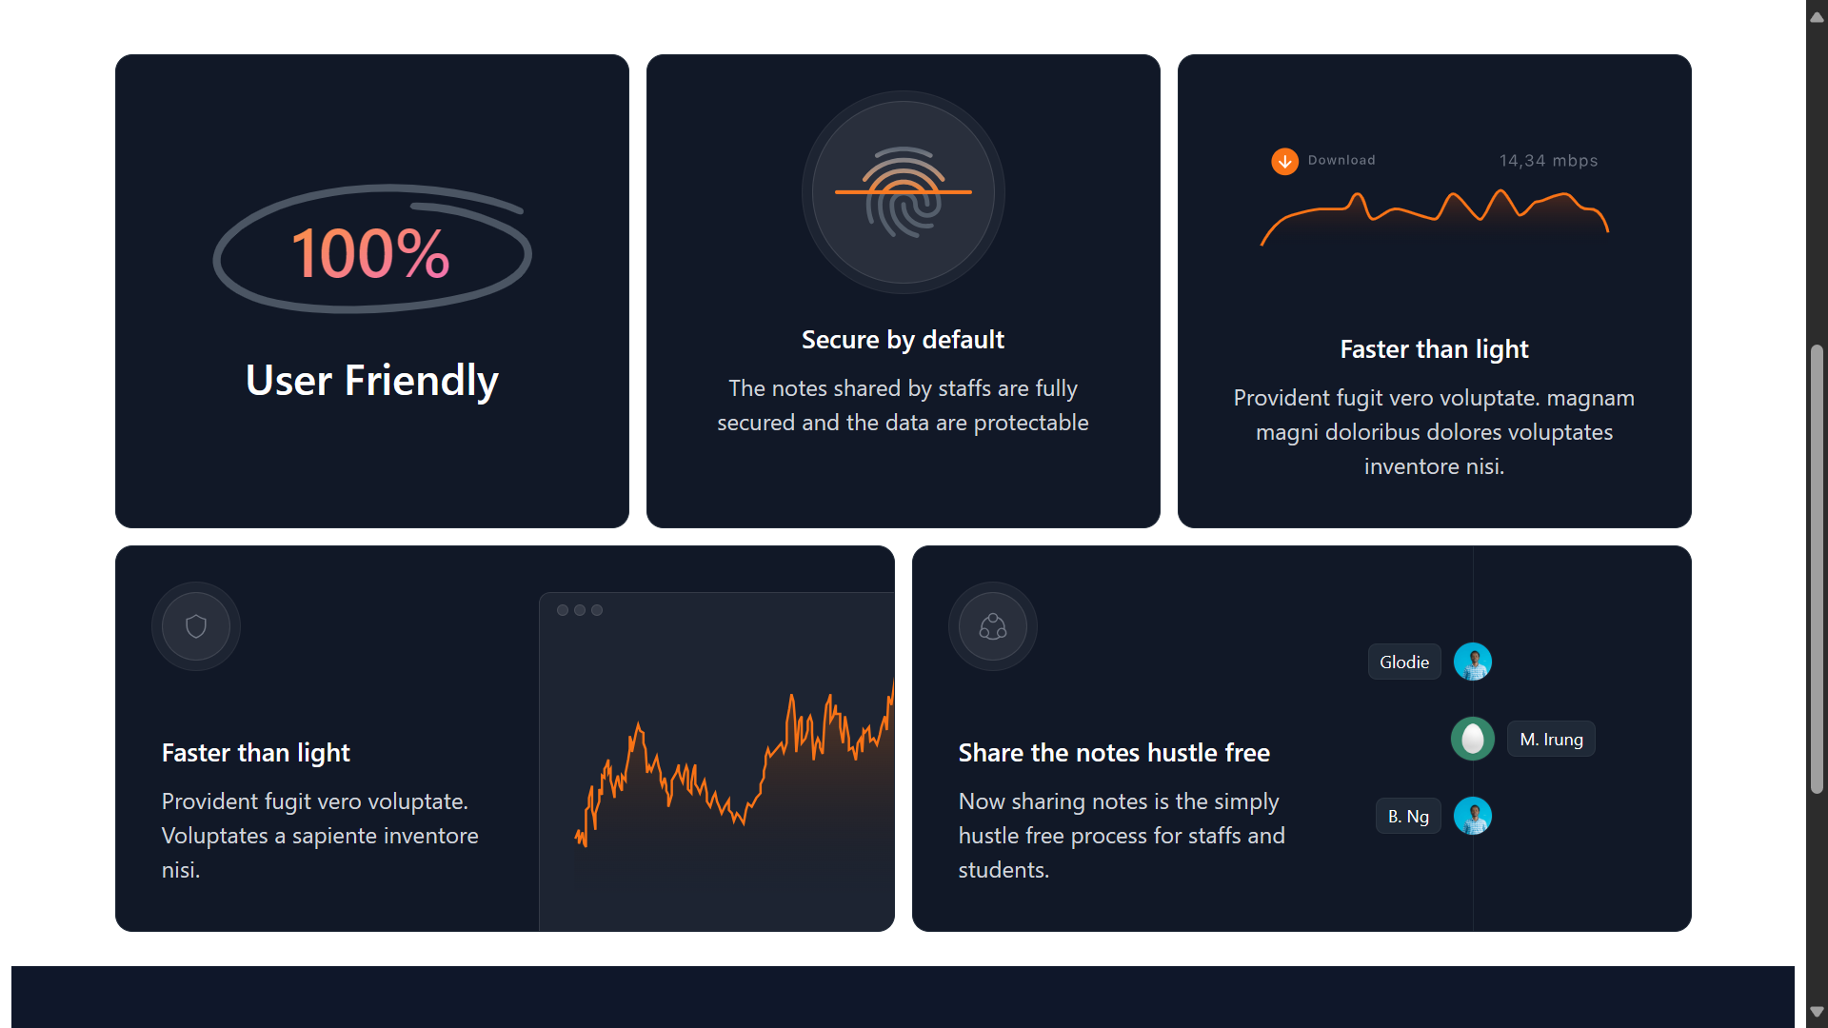
About-Us

Slide 13
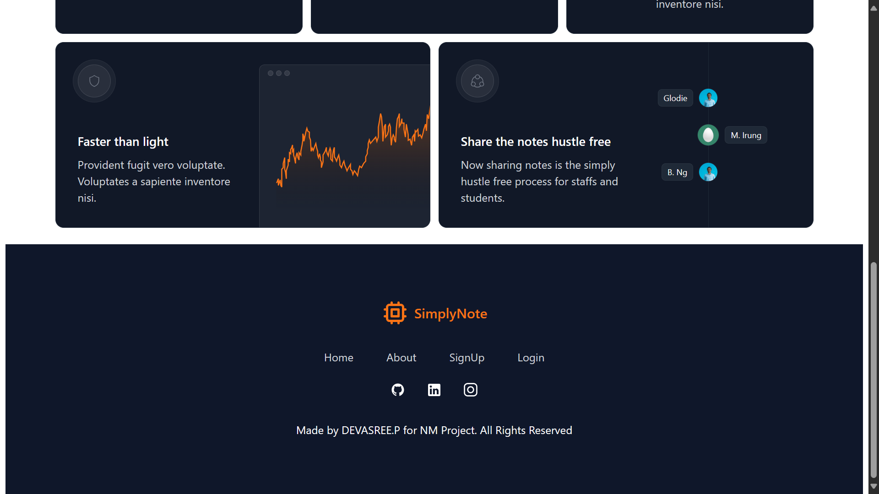
Service-Page

Slide 14
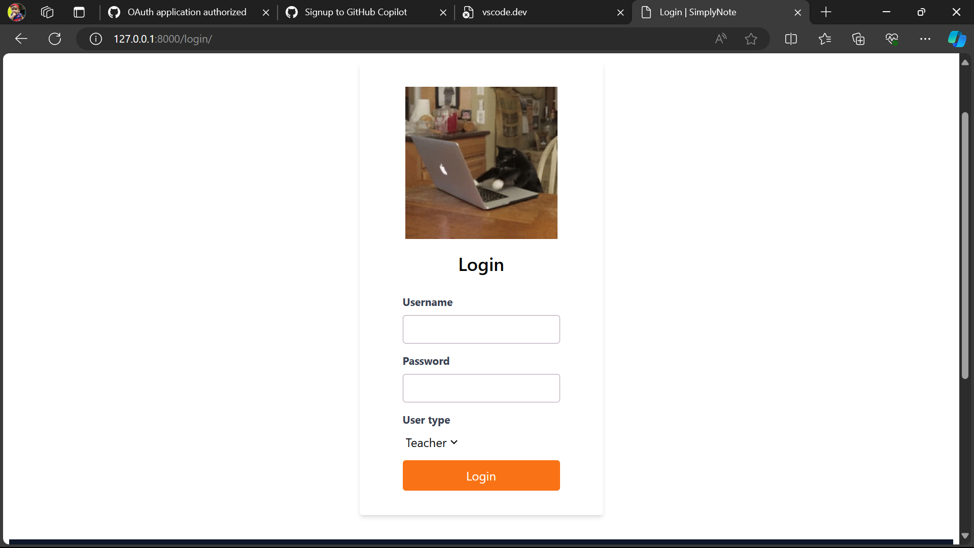
Login-page

Slide 15
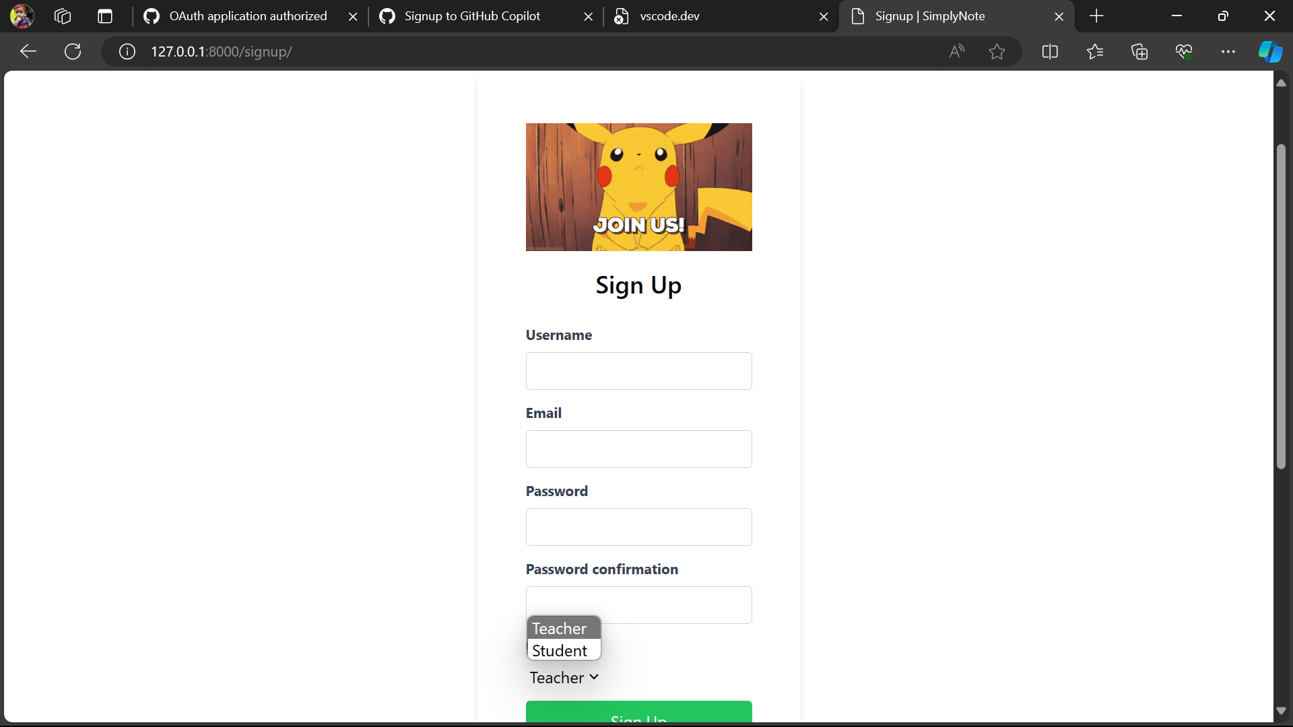
Sign Up-page

Slide 16
Future Enhancements
In the future, our note-sharing web application built on the Django framework could integrate advanced collaboration features to further enhance user engagement and productivity. One potential enhancement could be the implementation of real-time collaborative editing, allowing multiple users to simultaneously edit and collaborate on the same note in real-time. This feature would facilitate seamless teamwork and
brainstorming sessions, enabling users to collaborate more effectively regardless of their geographical locations. Additionally, we could explore the integration of version control mechanisms, similar to those used in popular collaborative platforms like Google Docs, to track and manage changes made to notes over time. Overall, these future enhancements would elevate the collaborative capabilities of our note-sharing web application, empowering users to collaborate more efficiently and effectively in their note-taking and sharing endeavors.

Slide 17
Conclusion
In conclusion, our note-sharing web application using Django offers a user-friendly solution for efficient note organization and collaboration. As we move forward, we aim to enhance the platform with real-time collaborative editing, version control, and advanced commenting features. We remain dedicated to evolving our application to meet the dynamic needs of users in the ever-changing digital landscape. Our commitment to innovation ensures continuous improvement, meeting the evolving needs of users and setting new standards in note-sharing technology.

Slide 18
Thank You!
Notes:
Thank You !!

